Slide 1

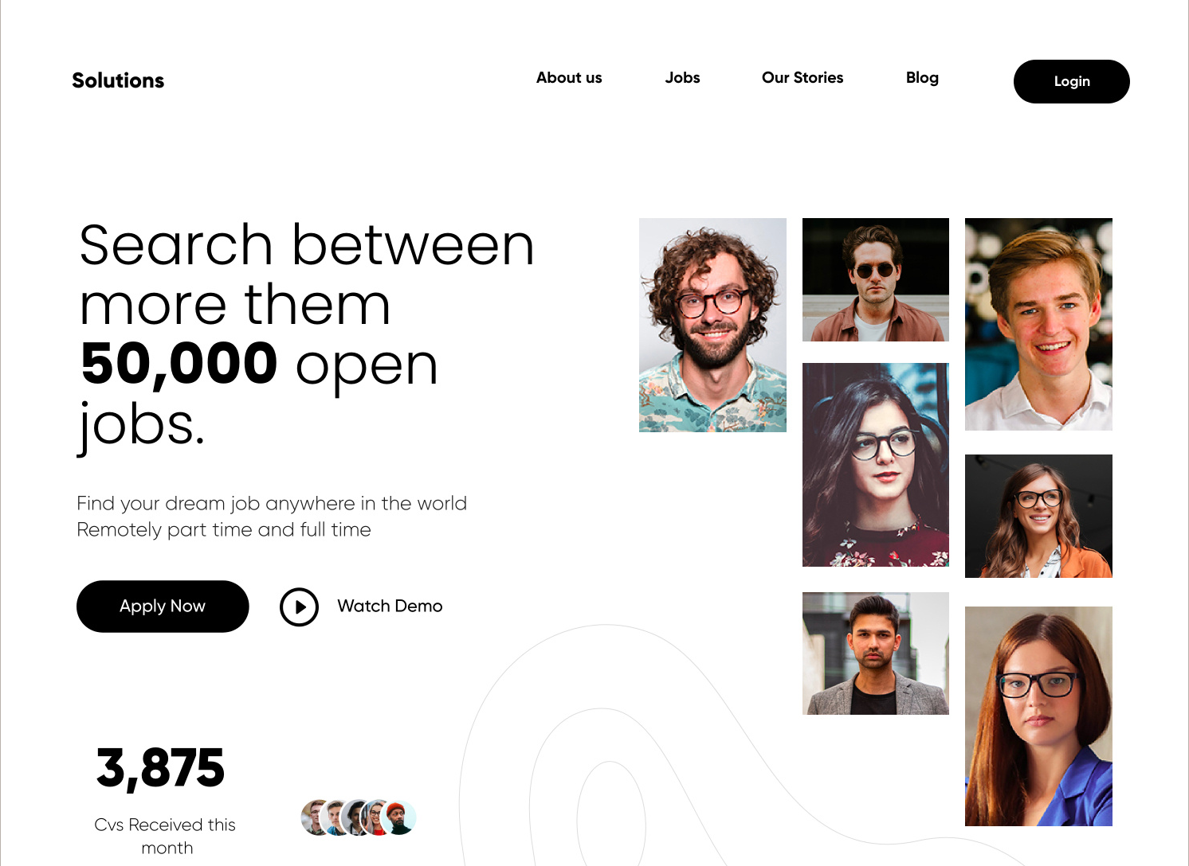
GROUP 13
ANVITHA LAKSHMISHA
SHREYA SARVANAN
DIPEN MANOJ PATEL
BHAVESH RAJA RAMPALLY
JOB
APPLICATION TRACKER

Slide 2






PROJECT HIGHLIGHTS
Streamlined talent acquisition, a smooth job application process, allowing for effective tracking and evaluation of applications.
TRACK AND ORGANISE
JOB LISTINGS
SAVE POTENTIAL JOBS
APPLICATION STATUS
DOCUMENTS
DASHBOARD AND REPORTS

Slide 3

DESIGN DOCUMENT
Establishing guidelines for a coherent and effective database design.
COMPANIES AND JOB LISTINGS
Each company can have multiple job listings.
Every company must be associated with at least one recruiter.
APPLICANTS AND CAREER DETAILS
Each applicant must possess one or more education history records.
Applicants can apply to multiple jobs (applied jobs) and save job listings.
Each applicant must maintain a single, comprehensive profile.
Optional: Applicants can showcase various skills and documents.
JOBS AND LISTINGS RELATIONSHIPS
Jobs (applied or saved) can be linked to multiple job listings.

Slide 4
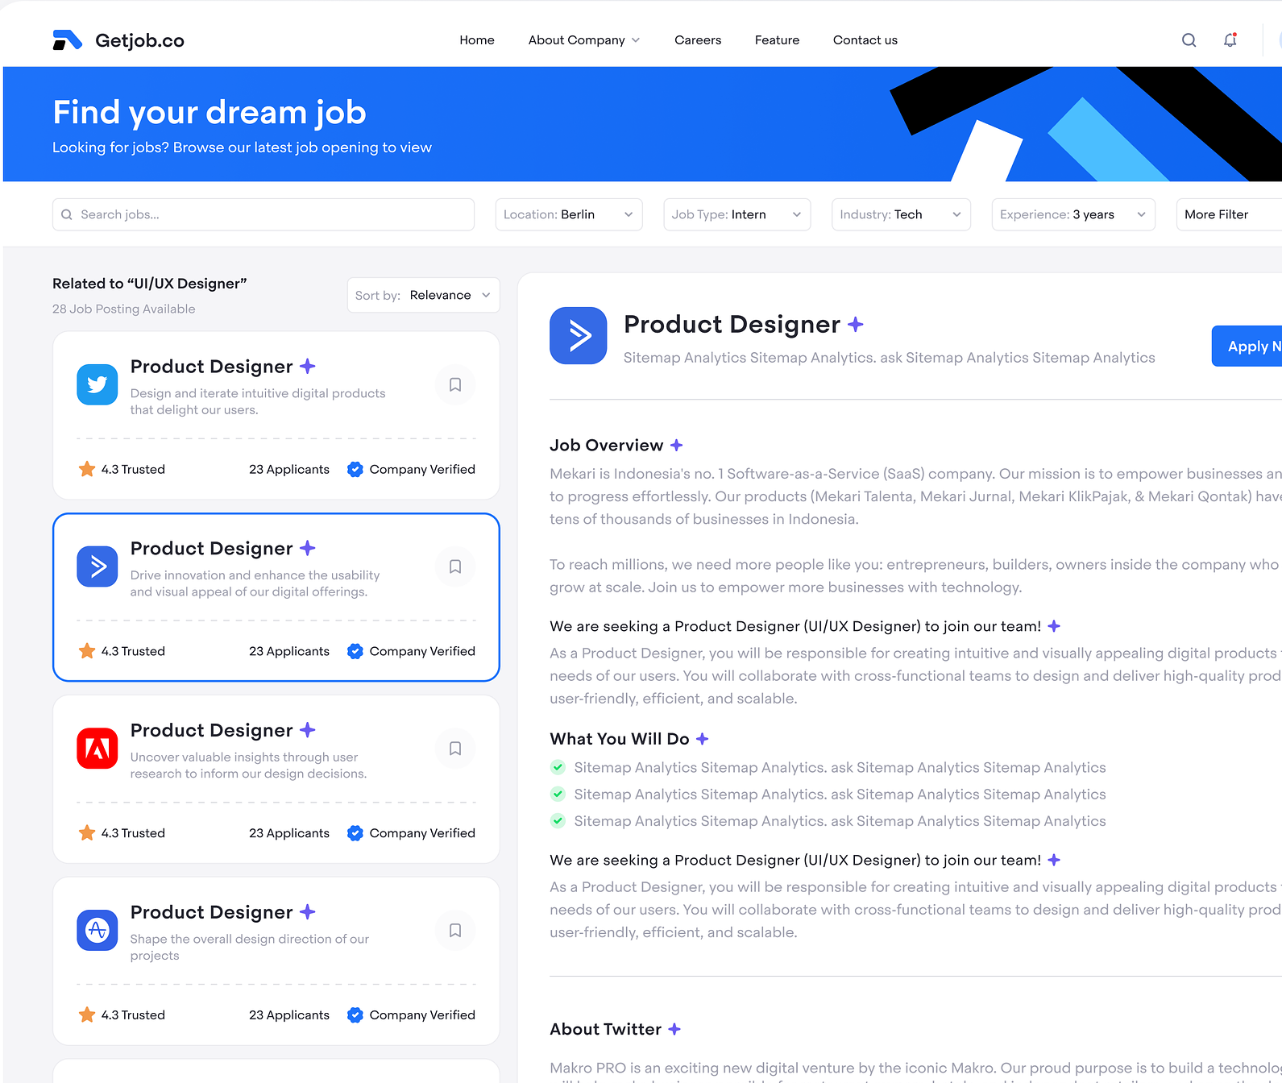
DESIGN DOCUMENT CONT'D
APPLIED JOBS AND INTERVIEWS
Applied jobs must have an application status.
Optionally, an applied job can have multiple interview records.
ADDRESSES IN THE SYSTEM
Each company and each applicant must have a unique address.
RECRUITERS AND JOB LISTINGS
Recruiters can manage multiple job listings.
Each job listing is associated with one recruiter.

Slide 5
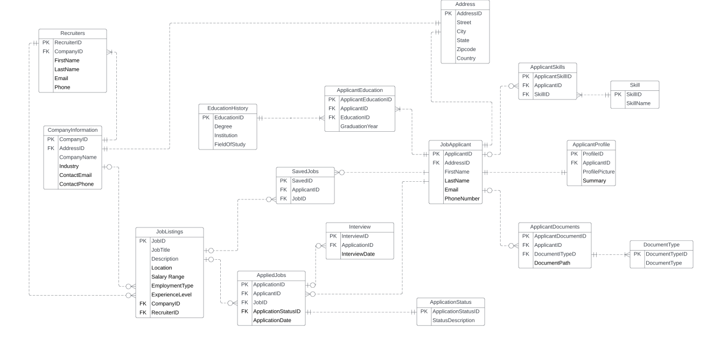
ENTITY RELATIONSHIP DIAGRAM

Slide 6
SQL DDL STATEMENTS
CREATE TABLE Address (
AddressID varchar(50) PRIMARY KEY,
Street varchar(50) NOT NULL,
City varchar(50) NOT NULL,
State varchar(50) NOT NULL,
Zipcode bigint NOT NULL,
Country varchar(50) NOT NULL,
CONSTRAINT CHK_Zipcode CHECK (Zipcode >= 1000 AND Zipcode <= 99999)
);
CREATE TABLE CompanyInformation (
CompanyID varchar(50) PRIMARY KEY,
AddressID varchar(50) NOT NULL,
CompanyName varchar(255) NOT NULL,
Industry varchar(255) NOT NULL,
ContactEmail varchar(255) NOT NULL,
ContactPhone bigint NOT NULL,
CONSTRAINT FK_Address_CompanyInformation
FOREIGN KEY (AddressID)
REFERENCES Address(AddressID),
CONSTRAINT UQ_CompanyName
UNIQUE (CompanyName, ContactEmail, ContactPhone)
);
Create table EducationHistory
(EducationID varchar(50) primary key,
Degree varchar(255) not null,
Institution varchar(100) not null,
FieldOfStudy varchar(100) not null);
CREATE TABLE ApplicantEducation (
ApplicantEducationID varchar(50) PRIMARY KEY,
ApplicantID varchar(50) NOT NULL,
EducationID varchar(50) NOT NULL,
GraduationYear int NOT NULL,
CONSTRAINT FK_Applicant_JobApplicant
FOREIGN KEY (ApplicantID)
REFERENCES JobApplicant(ApplicantID),
CONSTRAINT FK_Education_EducationHistory
FOREIGN KEY (EducationID)
REFERENCES EducationHistory(EducationID),
CONSTRAINT CHK_GraduationYear CHECK (GraduationYear >= 1900 AND GraduationYear <= YEAR(GETDATE()))
);
CREATE TABLE Recruiters (
RecruiterID varchar(50) PRIMARY KEY,
CompanyID varchar(50) NOT NULL UNIQUE,
FirstName varchar(255) NOT NULL,
LastName varchar(255) NOT NULL,
Email varchar(255) NOT NULL,
Phone bigint NOT NULL,
CONSTRAINT FK_CompanyInformation_Recruiters
FOREIGN KEY (CompanyID)
REFERENCES CompanyInformation(CompanyID)
);
CREATE TABLE JobApplicant (
ApplicantID varchar(50) PRIMARY KEY,
AddressID varchar(50) NOT NULL,
FirstName varchar(255) NOT NULL,
LastName varchar(255) NOT NULL,
Email varchar(255) NOT NULL Unique,
PhoneNumber bigint NOT NULL,
CONSTRAINT FK_Address_JobApplicant
FOREIGN KEY (AddressID)
REFERENCES Address(AddressID)
);

Slide 7
SQL DDL STATEMENTS
CREATE TABLE ApplicantSkills (
ApplicantSkillID varchar(50) PRIMARY KEY,
ApplicantID varchar(50) NOT NULL,
SkillID varchar(50) NOT NULL,
CONSTRAINT FK_Applicant_JobApplicant_ApplicantSkills
FOREIGN KEY (ApplicantID)
REFERENCES JobApplicant(ApplicantID),
CONSTRAINT FK_Skill_Skill
FOREIGN KEY (SkillID)
REFERENCES Skill(SkillID)
);
CREATE TABLE JobListings (
JobID varchar(50) PRIMARY KEY,
JobTitle varchar(100) NOT NULL,
Description varchar(1000) NOT NULL,
Location varchar(100) NOT NULL,
SalaryRange bigint NOT NULL,
EmployeeType varchar(255) NOT NULL,
ExperienceLevel varchar(255) NOT NULL,
CompanyID varchar(50) NOT NULL,
RecruiterID varchar(50) NOT NULL,
CONSTRAINT FK_CompanyInformation_JobListings
FOREIGN KEY (CompanyID)
REFERENCES CompanyInformation(CompanyID),
CONSTRAINT FK_Recruiters_JobListings
FOREIGN KEY (RecruiterID)
REFERENCES Recruiters(RecruiterID)
);
CREATE Table skill
(SkillID varchar(50) primary key,
SkillName varchar(255) not null);
CREATE Table DocumentType
(DocumentTypeID varchar(50) primary key,
DocumentType varchar(50) not null);
CREATE TABLE ApplicantDocuments (
ApplicantDocumentID varchar(50) PRIMARY KEY,
ApplicantID varchar(50) NOT NULL,
DocumentTypeID varchar(50) NOT NULL,
DocumentPath varchar(255) NOT NULL,
CONSTRAINT FK_Applicant_JobApplicant_ApplicantDocuments
FOREIGN KEY (ApplicantID)
REFERENCES JobApplicant(ApplicantID),
CONSTRAINT FK_DocumentType_DocumentType
FOREIGN KEY (DocumentTypeID)
REFERENCES DocumentType(DocumentTypeID)
);
CREATE TABLE ApplicantProfile (
ProfileID varchar(50) PRIMARY KEY,
ApplicantID varchar(50) NOT NULL,
Summary varchar(255) NOT NULL,
ProfilePicture varchar(100) NOT NULL,
CONSTRAINT FK_Applicant_JobApplicant_ApplicantProfile
FOREIGN KEY (ApplicantID)
REFERENCES JobApplicant(ApplicantID)
);
CREATE table ApplicationStatus
(ApplicationStatusID varchar(50) primary key,
StatusDescription varchar(255) not null);

Slide 8
SQL DDL STATEMENTS
CREATE TABLE AppliedJobs (
ApplicationID varchar(50) PRIMARY KEY,
ApplicantID varchar(50) NOT NULL,
JobID varchar(50) NOT NULL,
ApplicationStatusID varchar(50) NOT NULL,
ApplicationDate DATETIME DEFAULT GETDATE() NOT NULL,
CONSTRAINT FK_Applicant_JobApplicant_AppliedJobs
FOREIGN KEY (ApplicantID)
REFERENCES JobApplicant(ApplicantID),
CONSTRAINT FK_JobListings_AppliedJobs
FOREIGN KEY (JobID)
REFERENCES JobListings(JobID),
CONSTRAINT FK_ApplicationStatus_AppliedJobs
FOREIGN KEY (ApplicationStatusID)
REFERENCES ApplicationStatus(ApplicationStatusID)
);
CREATE TABLE Interview (
InterviewID varchar(50) PRIMARY KEY,
ApplicationID varchar(50) NOT NULL,
InterviewDate date NOT NULL,
CONSTRAINT FK_AppliedJobs_Interview
FOREIGN KEY (ApplicationID)
REFERENCES AppliedJobs(ApplicationID)
);
CREATE TABLE SavedJobs (
SavedID varchar(50) PRIMARY KEY,
ApplicantID varchar(50) NOT NULL,
JobID varchar(50) NOT NULL,
CONSTRAINT FK_Applicant_JobApplicant_savedJobs
FOREIGN KEY (ApplicantID)
REFERENCES JobApplicant(ApplicantID),
CONSTRAINT FK_JobListings_SavedJobs
FOREIGN KEY (JobID)
REFERENCES JobListings(JobID)
);

Slide 9
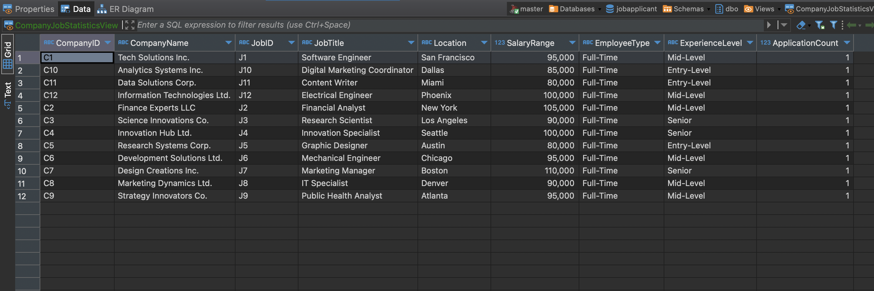
COMPANY JOB STATISTICS VIEW
why this view
view provides a consolidated and summarized perspective on job statistics, making it easier for analysts and decision-makers to derive insights from the data.

Slide 10
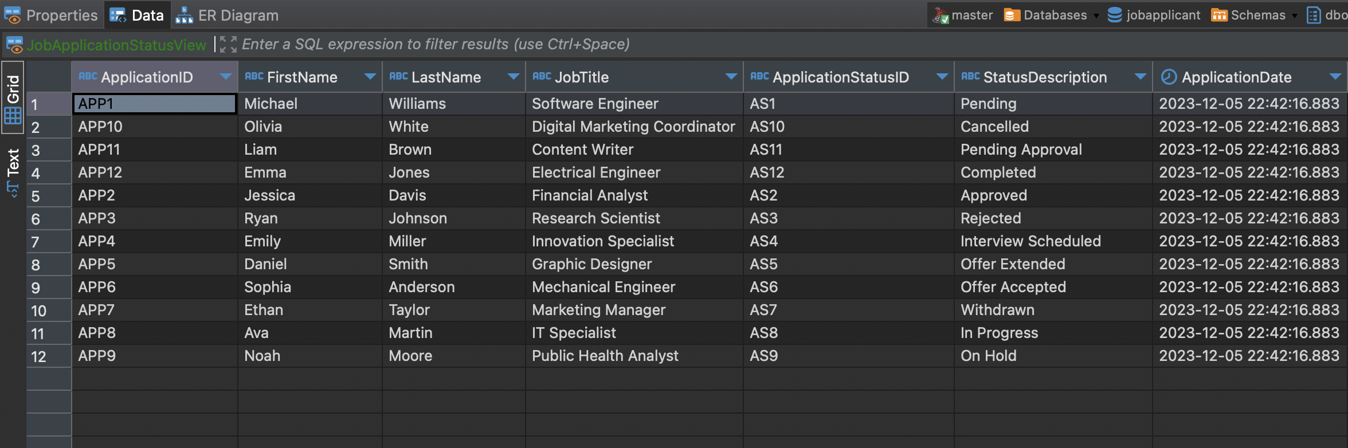
JOB APPLICATION STATUS VIEW
why this view
this view is to analyze and understanding the relationships between job applicants, their profiles, and the jobs they have applied for across different companies

Slide 11
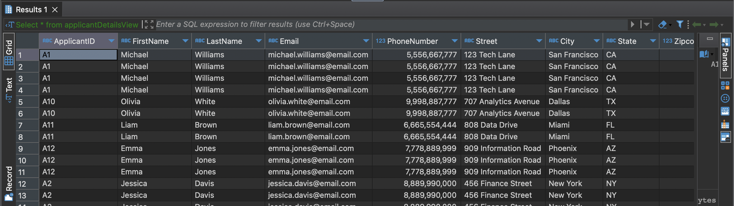
JOB APPLICANT DETAILS
why this view
This view can be queried like a regular table to retrieve information about job applications in a simplified manner
IT shows all the Entity related to Applicant

Slide 12
CONSTRAINTS AND ENCRYPTION
Table level constraint based on functions
1. CheckRecruiterCompany : A check to verify that the job listing has a recruiter who is working in the same company that the job listing is posted from.
2.IsValidPhoneNumber: A basic check to make sure that the minimum number of digits in a phone number is 10
3. IsValidEmail: A simple check to verify the email is following the standard format
4. CheckFutureDate: Check on the Interview table to make sure that the interview dates are all in the future.
Column level encryption
ProfilePicture and DocumentPath
- Privacy protection, client and user trust, security compliance and Preventing unauthorized access

Slide 13
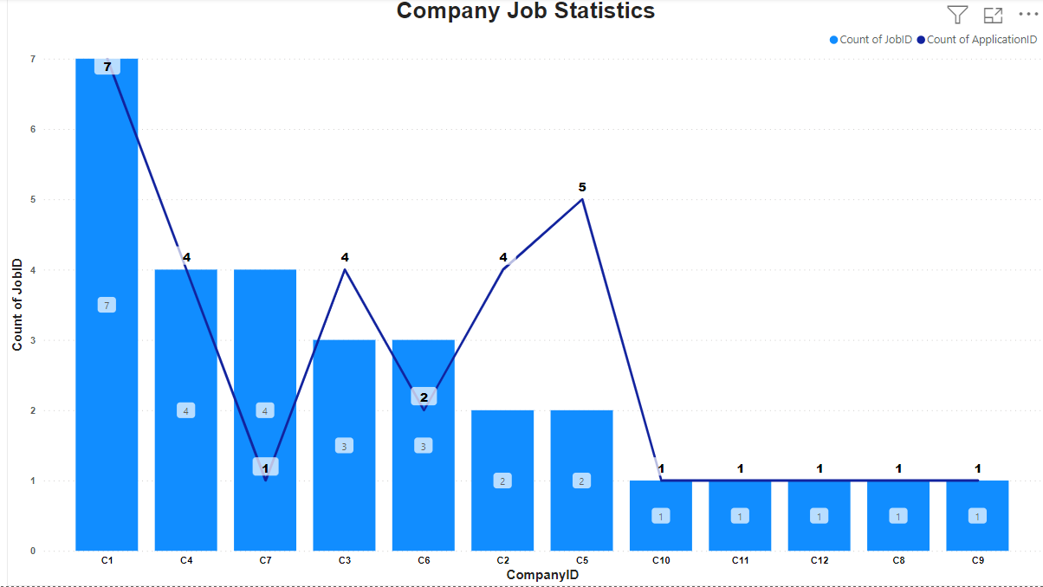
Shows a detailed picture of the number of jobs each company has and the number of applicants for each company

Slide 14
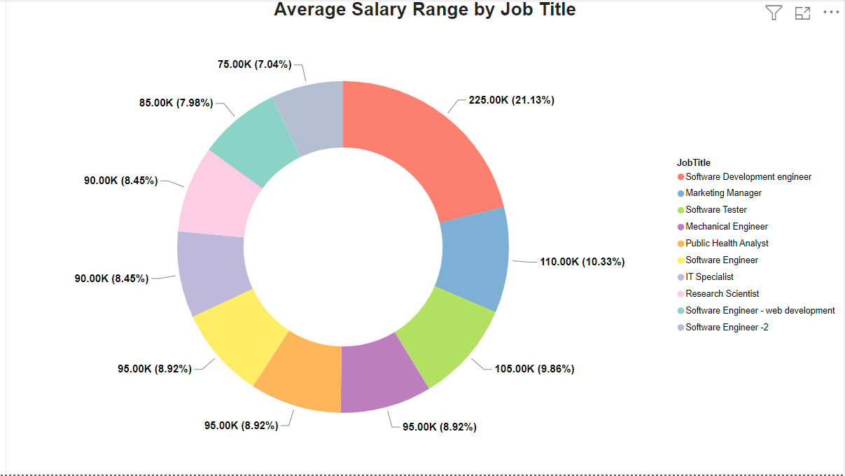
Gives a picture of the average salary of top 10 different job titles

Slide 15
THANK YOU

